Slide 1


ADVANCED IMAGE COMPRESSION AND IMAGE RESTORATION TECHNIQUES
EDS 6397
DIGITAL IMAGE PROCESING
- Group 11

Slide 2



INTRODUCTION
Image Compression: Reduces image size while maintaining quality, essential for efficient storage, faster data transfer, and reduced bandwidth in web applications.
Market Value: Projected to exceed $7 billion by 2030, driven by AI advancements and data consumption.
Examples:
Google: WebP and AVIF to optimize web and YouTube content.
Netflix: Advanced compression for efficient streaming.
Adobe: Compression tools in Photoshop and Lightroom.
Significance: Critical for streaming, e-commerce, and cloud storage, saving costs and improving performance.

Slide 3




INTRODUCTION
Image Restoration: Recovers degraded or low-quality images by addressing noise, blur, and artifacts.
Market Value: Part of the AI-driven image processing market, projected at $30 billion by 2028.
Examples:
Healthcare: GE and Philips enhance medical imaging.
Media: Disney restores classic films.
Surveillance: Hikvision improves low-quality footage.
Consumer Tools: Google Photos and Photoshop integrate restoration models.
Significance: Essential for healthcare, archives, and security, where clarity and detail are critical.

Slide 4


DATASET OVERVIEW: DIV2K DATASET
Dataset Size: 1,000 high-resolution images
Image Resolution: 2K resolution (1920x1080) or higher
Split:
Training: 630 images
Validation: 180 images
Testing: 90 images
Feature Type: RGB images,
Ideal for high-resolution image
processing and restoration tasks
Annotations: No class labels, focusing on quality-based tasks
DIV2K
(900 IMAGES)
TRAIN_HR
TRAIN
Kaggle.json
NOISE
TRAIN_LR
VALIDATE_HR
VALIDATE
NOISE
VALIDATE_HR
TEST_HR
TEST
TEST_HR
NOISE

Slide 5
METHODOLOGY
IMAGE COMPRESSION
AVIF
WEBP
Compared using
PSNR,
SSIM,
Compression Ratio
IMAGE
JPEG
JPEG 2000
PNG
MODERN
TRADITIONAL
Implementation (Demo): Link

Slide 6
METHODOLOGY (contd.)
Format | Algorithm | Key Features | Use Cases
AVIF | Based on AV1 codec | High compression, HDR, 10-bit color | Modern web apps, HDR images
WebP | VP8 + Lempel-Ziv | Lossy/lossless, transparency, animations | Web optimization, fast loading, animations
JPEG | Discrete Cosine Transform | Widely supported, lossy, small size | Everyday photos, low-storage needs
JPEG 2000 | Discrete Wavelet Transform | High quality, lossless/lossy, progressive | Archives, medical/scientific images
PNG | DEFLATE (lossless) | Transparency, perfect quality | Logos, graphics, editing, lossless needs

Slide 7
IMAGE RESTORATION
Model: U-Net, DnCNN {Locally Trained}
TRAIN_HR
LOSS FUNCTION
OPTIMIZER
METRICS
TRAIN_LR
PREPROCESSING
MODEL TRAINING
VALIDATION
VALIDATION_HR
BEST MODEL
VALIDATION_LR
OUTPUT
TEST_LR
TEST_HR
INPUT
GROUND TRUTH
Implementation for U-Net, DnCNN

Slide 8
IMAGE RESTORATION
Model: SwinIR, Real ESR-GAN {Pre-Trained}
PRE-TRAINED WEIGHTS
GROUND TRUTH
MODEL
TEST_LR
OUTPUT
TEST_HR
Implementation for SwinIR, Real_ESR-GAN
Comparison Metrics:
Compression Ratio:
Ratio of original size to compressed size.
Higher ratio = greater compression.
PSNR (Peak Signal-to-Noise Ratio):
Measures image quality after compression (in dB).
Higher PSNR = better quality, less distortion.
SSIM (Structural Similarity Index):
Compares original and compressed images based on human perception.
Ranges from 0 (poor) to 1 (perfect similarity).

Slide 9
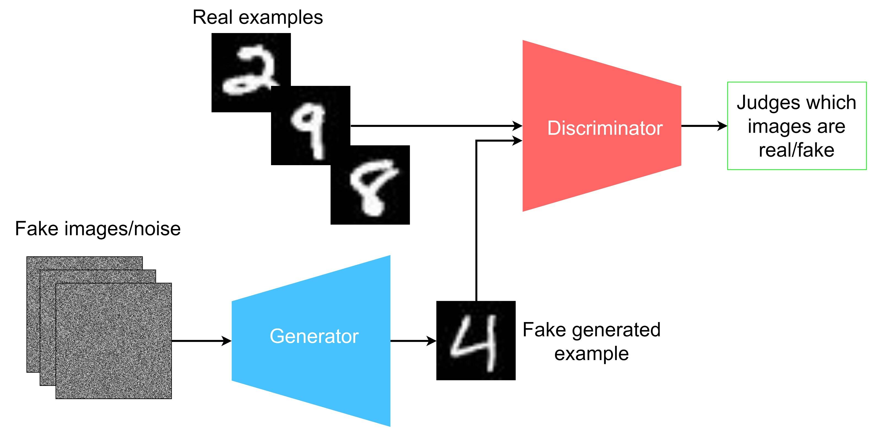
IMAGE RESTORATION
Model 1: Real ESR-GAN
How GAN works

Slide 10
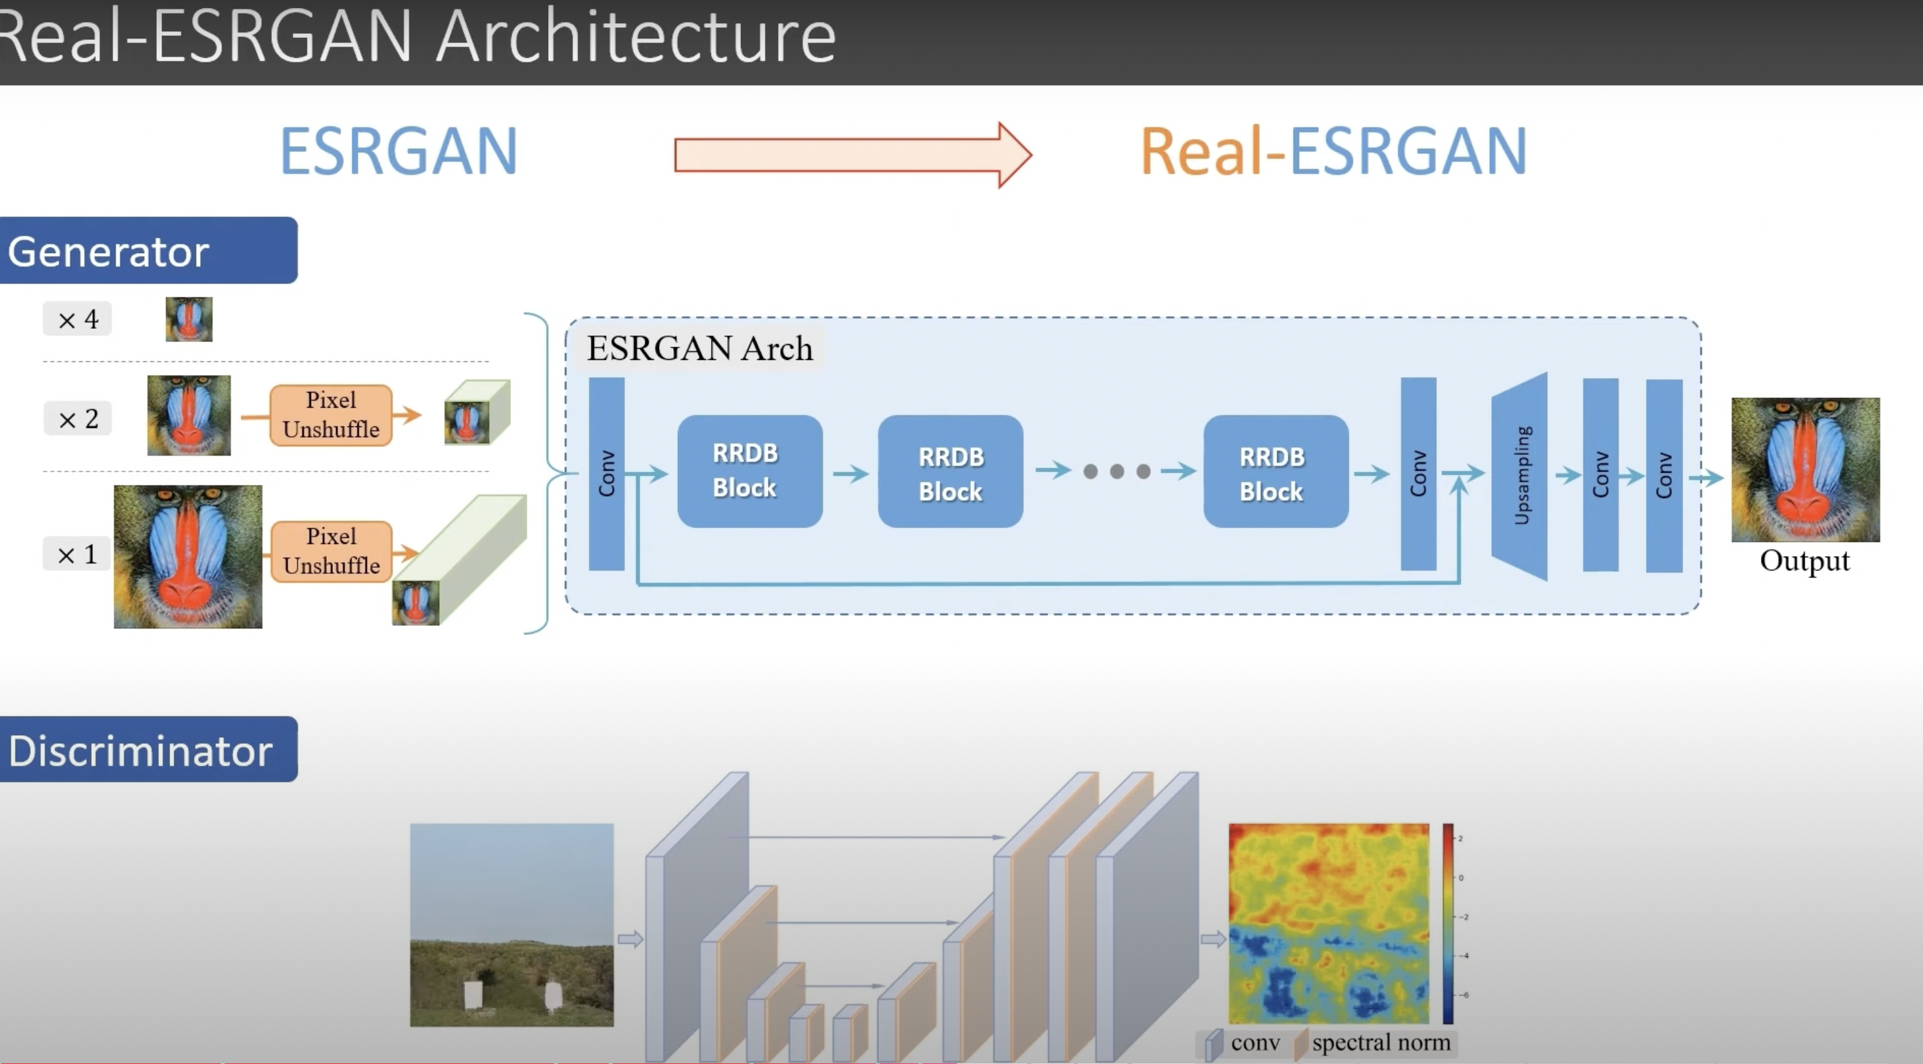
IMAGE RESTORATION
Model: Real ESR-GAN
Uses realistic degradation (blur, noise, compression artifacts) for better real-world performance.
Discriminator: U-Net discriminator; balances texture enhancement and artifact suppression.
Generator: Improved RRDB for better handling of diverse degradations.

Slide 11
COMPARING ARCHITECTURES
Model | Architecture | Key Features
U-Net | Encoder-decoder structure with skip connections. | Captures multi-scale features and retains spatial information via skip connections
 | Uses convolutional layers for feature extraction. | Effective for denoising, segmentation, and simpler restoration tasks.
DnCNN | Fully convolutional network with residual learning. | Removes noise directly by predicting residual noise.
 | Lacks multiscale or attention mechanisms. | Simple, lightweight, and effective for noise removal.

Slide 12
COMPARING ARCHITECTURES
Model | Architecture | Key Features
SwinIR | Transformer-based architecture using Swin Transformers. | Hierarchical feature extraction with attention mechanisms for long-range dependency capture.
 | Combines patch-wise processing and local-global attention mechanisms. | Handles fine-grained details and complex degradations effectively.
Real-ESRGAN | Based on RRDB (Residual-in-Residual Dense Block) architecture. | Tailored for real-world scenarios with robust feature extraction and realistic degradation handling.
 | Incorporates U-Net discriminator and realistic degradation modeling. | Balances perceptual quality with artifact suppression.

Slide 13
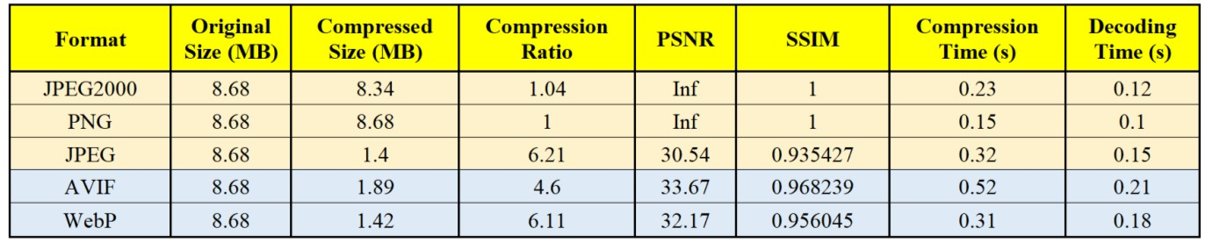
KEY RESULTS and FINDINGS
Image Compression

Slide 14
KEY RESULTS and FINDINGS
Image Compression
Best Quality: PNG and JPEG2000 provide perfect quality but minimal compression.
High Compression: JPEG (6.21) and WebP (6.11) compress well, with WebP offering better quality. AVIF achieves the best PSNR (33.67) and SSIM (0.9682).
Speed vs. Quality: WebP balances speed, compression, and quality efficiently.
Recommendation: AVIF for high-quality compression; WebP for fast and efficient web use.

Slide 15
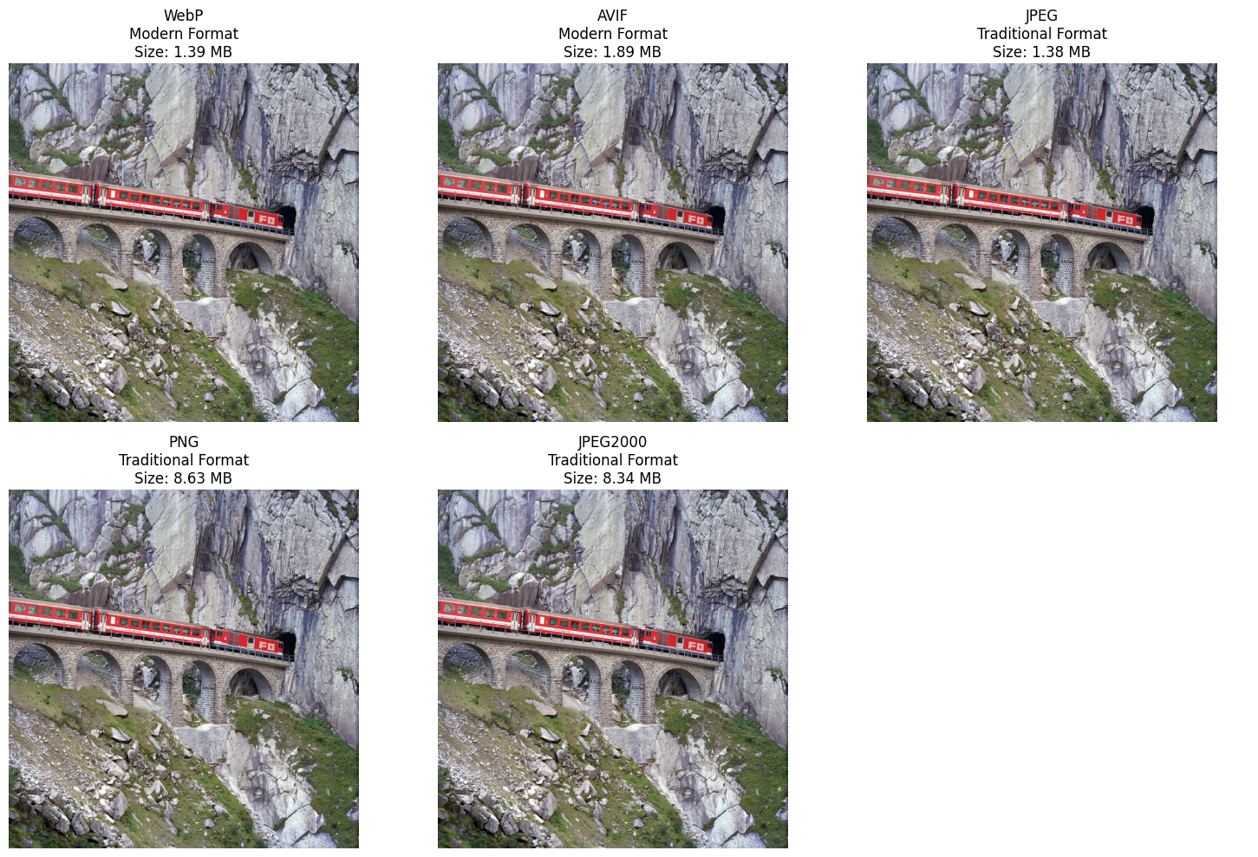
KEY RESULTS and FINDINGS
Image Compression

Slide 16
KEY RESULTS and FINDINGS
Image Restoration
Model | PSNR (dB) | SSIM
U-Net | 17.7 | 0.4017
SwinIR-Large | 21.11 | 0.544
SwinIR-Medium | 20.93 | 0.5336
DnCNN | 5.17 | 0.0517
Real ESR_GAN | 26.69 | 0.8684

Slide 17
KEY RESULTS and FINDINGS
Image Restoration
Best Performance: Real-ESRGAN achieves the highest PSNR (26.69 dB) and SSIM (0.8684), making it the best for quality and perceptual similarity.
Transformer Models: SwinIR-Large and SwinIR-Medium outperform U-Net and DnCNN; SwinIR-Large slightly leads with better parameters.
U-Net: Moderate performance (PSNR: 17.7 dB, SSIM: 0.4017), suitable for general restoration but less effective than Real-ESRGAN and SwinIR.
DnCNN: Lowest PSNR (5.17 dB) and SSIM (0.0517), unsuitable for complex or real-world restorations.
Real-ESRGAN Advantage: Excels in balancing fidelity and perceptual quality.

Slide 18
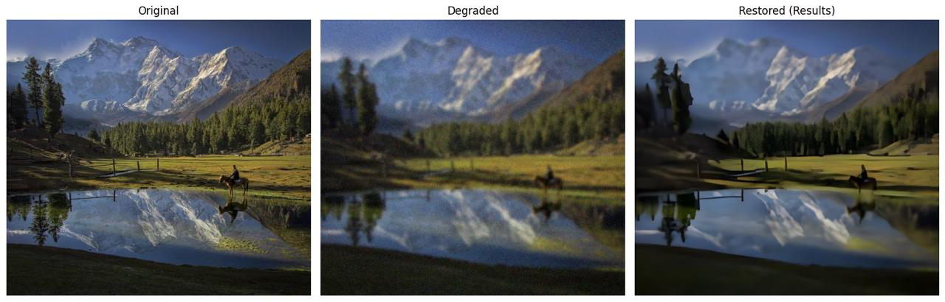
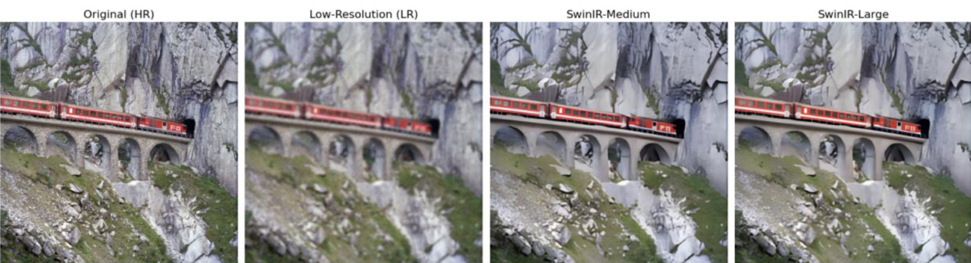
KEY RESULTS and FINDINGS
Image Restoration:
Real ESR-GAN
Swin-IR

Slide 19
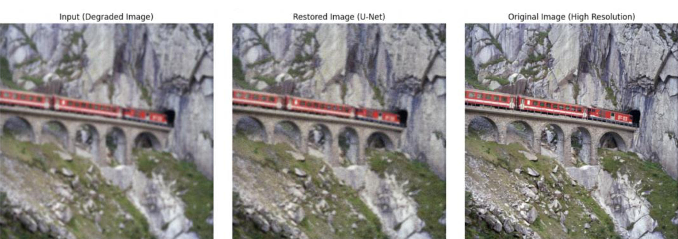
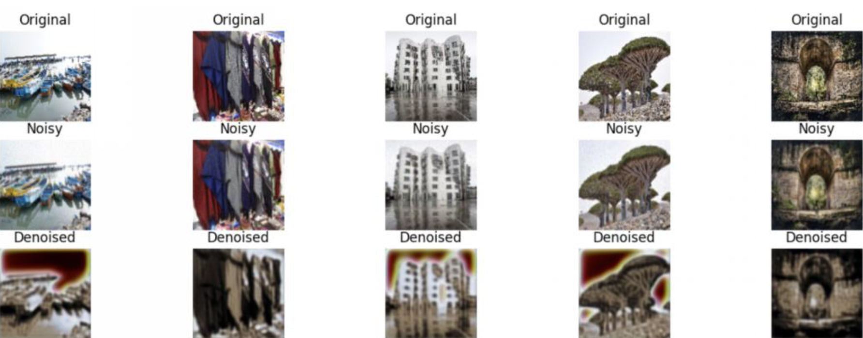
KEY RESULTS and FINDINGS
Image Restoration:
U-Net
DnCNN

Slide 20
KEY RESULTS and FINDINGS
Best Performance: Real-ESRGAN achieves the highest PSNR (26.69 dB) and SSIM (0.8684), making it the best for quality and perceptual similarity.
Transformer Models: SwinIR-Large and SwinIR-Medium outperform U-Net and DnCNN; SwinIR-Large slightly leads with better parameters.
U-Net: Moderate performance (PSNR: 17.7 dB, SSIM: 0.4017), suitable for general restoration but less effective than Real-ESRGAN and SwinIR.
DnCNN: Lowest PSNR (5.17 dB) and SSIM (0.0517), unsuitable for complex or real-world restorations.
Real-ESRGAN Advantage: Excels in balancing fidelity and perceptual quality.

Slide 21
Challenges faced and how they are addressed
Evaluation Challenges:
Challenge: Metrics computation on large datasets.
Solution: Leveraged GPUs and batch processing.
Data Preprocessing:
Challenge: Managing paired LR and HR images.
Solution: Automated consistent preprocessing.
Mismatched Dimensions:
Challenge: Restored images didn’t match ground truth.
Solution: Resized restored images before evaluation.
SSIM Errors:
Challenge: "win_size exceeds image extent" error.
Solution: Adjusted win_size to fit the smallest dimension.

Slide 22
Future Work and Potential Applications
Future Work:
Develop realistic degradation models for real-world scenarios.
Optimize models for faster, memory-efficient deployment.
Use advanced perceptual metrics like LPIPS and user studies.
Expand applications to video enhancement and medical imaging.
Improve model generalization for unseen degradations.
Potential Applications:
Photography: Enhance and upscale images for professionals.
Healthcare: Improve diagnostic imaging like X-rays and MRIs.
Surveillance: Enhance degraded or low-resolution footage.
Heritage: Restore old photos and historical artifacts.
Web/Mobile: Optimize images for faster loading and better quality.
Satellite: Enhance images for urban planning and environmental studies

Slide 23

RESOURCES
| REPOSITORY (GITHUB)
Code Demonstration Videos:
Image Compression:
Link
Image Restoration:
U-Net
Swin-IR
DnCNN
Real-ESR-GAN

Slide 24
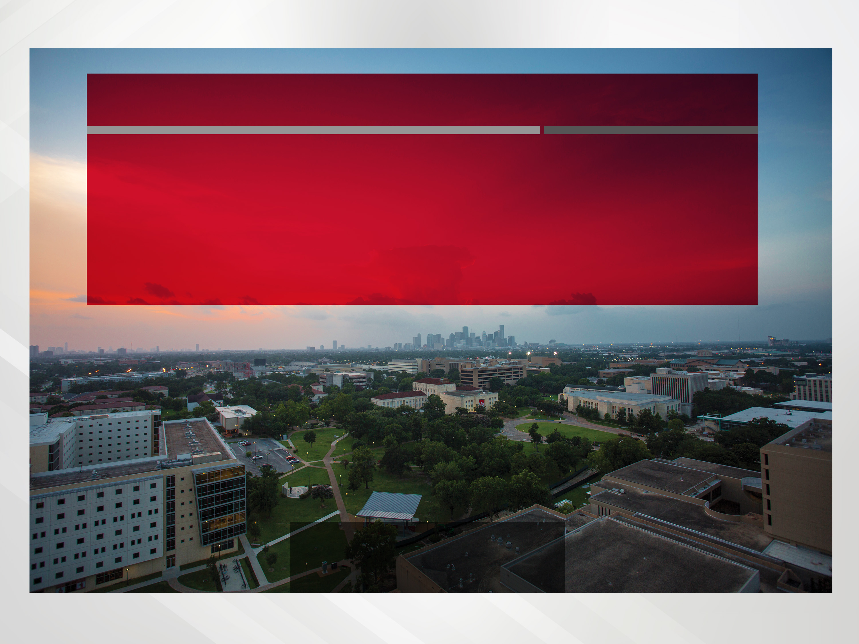
THANK YOU

